Slide 1
Conditional Probability

Slide 2
Conditional Probability
Is the probability that a certain event would
occur given a previous underlying event
already occur
Suppose the Mapua Mathematics Society
has 15 officers of whom 8 are seniors and 7 are juniors. Among the seniors, 5 are dean’s listers. Among the juniors, 6 is a deans lister. A student picked at random is a dean’s lister. Given this information, what is the probability that he is a senior?

Slide 3
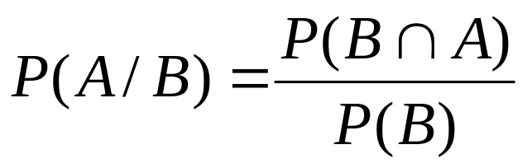
Conditional Probability
Is the probability that a certain event would
occur given a previous underlying event
already occur
The conditional probability of an event A given the occurrence of an event B is defined by
provided P(B) ≠ 0

Slide 4
Conditional Probability
Suppose the Mapua Mathematics Society
has 15 officers of whom 8 are seniors and 7 are juniors. Among the seniors, 5 are dean’s listers. A student picked at random is a dean’s lister. Given this information, what is the probability that he is a senior?

Slide 5
Conditional Probability
The probability that a person contracts a certain type of influenza is 0.2. Past experience has revealed that the probability that a person who gets influenza does not recover is 0.05. Find the probability that a randomly chosen person
a. contracts the influenza and does not recover
b. contracts the influenza and recovers

Slide 6
Conditional Probability
The princess comes from a family of 2 children.
What is the probability that the other child is
her brother?

Slide 7
Conditional Probability
A coin is flipped twice. What is the probability that both results in heads, given that the first flip does?

Slide 8
Conditional Probability
Suppose a card is picked at random from a deck of cards. Given that the card is a red card. Find the probability that it is a face card.

Slide 9
General Multiplication Law
If A and B are two events, then,
  P(A ∩ B) = P(A) P(B/A)
= P(B) P(A/B)

Slide 10
General Multiplication Law
In a particular geographic region, 60 percent of the people are regular smokers, and evidence indicates that 10 percent of the smokers have lung cancer. Find the percentage of people who are smokers and have lung cancer.

Slide 11
General Multiplication Law
In a particular geographic region, 60 percent of the people are regular smokers, and evidence indicates that 10 percent of the smokers have lung cancer. Find the percentage of people who are smokers and have lung cancer.

Slide 12
General Multiplication Law
The probability that a student studies is 0.7. Given that he studies, the probability that he will pass a course is 0.8. Given that he does not study, the probability that he will pass the course is 0.4. Find the probability that
a. he will study and pass the course
b. he will not study and will pass the course
c. he will pass the course

Slide 13
Independent Events
IIf two events A and B are independent, then
P(A ∩ B) = P(A) P(B)

Slide 14
Independent Events
Box A contains 8 items of which 5 are defective while box B contains 10 items of which 6 are defective. An item is chosen from each box. Find the probability that
(a) both are defective,
(b) one item is defective and the other is not

Slide 15
Independent Events
The probabilities that an officer receives 0, 1, 2 or 3 calls during a half-hour period are, respectively, 0.1, 0.2, 0.4, and 0.3. It is safe to assume that the number of phone calls received during any two non-over lapping time periods is independent. Find the probability that during the two time periods 10:00 – 10:30 and 2:00 – 2:30 together
a. no calls will be received
b. three calls will be received
c. four calls will be received

Slide 16
Independent Events
The probability that a plane arrives at the airport before 10:00 A.M. is 0.7. The probability that a passenger leaving from city by bus arrives at the airport by 10:00 A.M. is 0.6. Find the probability that
a. the plane and the passenger both arrive by 10:00 A.M.
b. the plane arrives by 10:00 A.M. and the passenger arrives after 10:00 A.M.

Slide 17
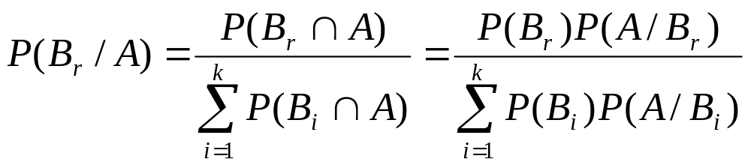
Baye’s Theorem
If the events B₁, B₂, ….., B_{k} constitute a partition of the sample space S, Where P(B_{i}) ≠ 0 for i = 1, 2, …, k, then for any event A in S such that P(A) ≠ 0
for r = 1, 2, …., k.

Slide 18
Baye’s Theorem
There are 3 coins in a box. One is a two-
headed coin, another is a fair-coin, and the
third is a biased-coin that comes up heads
75% of the time. When one of the 3 coins is
selected at random and flipped, it shows heads.
What is the probability that is was the two-
headed coin?

Slide 19
Baye’s Theorem
2. Stores A, B, and C have 50, 75, and 100 employees
and, respectively, 50, 60, and 70 percent of those
are women. Resignations are equally likely among all
employees regardless of sex. One employee resigns,
and this a woman. What is the probability that she
works in store C?

Slide 20
Baye’s Theorem
2. English and American spelling are rigour
and rigor, respectively. A man staying at a
Parisian Hotel writes this word, and a letter
taken at random from his spelling is found to
be a vowel. If 40% of the English-speaking
men at the hotel are English and 60% are
Americans, what is the probability that the
writer is an English-man?

Slide 21
Baye’s Theorem
2. Consider two boxes, one containing 1
black and 1 white marble, the other 2 black
and 1 white marble. A box is selected at
random, and a marble is drawn at random
from the selected box. What is the
probability that the marble is black? What is
the probability that the first box was the one
selected, given that the marble is white?

